Slide 1
ME 552 Thermal and Fluid Sciences Laboratory
Lecture 1
Notes:
ME 451

Slide 2
Objective for Lecture
Gain an introduction to measurement systems

Slide 3
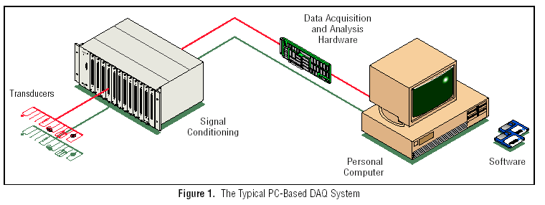
A Typical Measurement System
Components:
1) Sensor 2) Transducer 3) Signal conditioning and 4) Signal Analysis, display, and/or storage
Sensors: component that directly responds to the variable (physical phenomenon) that needs to be measured
Transducers convert the sensed variable and produce electrical signals that the data acquisition system measures
For example, thermocouples, resistance temperature detectors (RTDs), thermistors convert temperature into an analog electrical signal
Signal conditioning may involve such tasks as amplification of low-level signals, isolation, noise filtering, A/D, D/A to provide for more accurate measurements/ analysis.
In addition, it supplies excitation power to active transducers
Source: National Instruments, “Data Acquisition Basics,” Application Note 007, April 2002
Notes:
ME 451

Slide 4
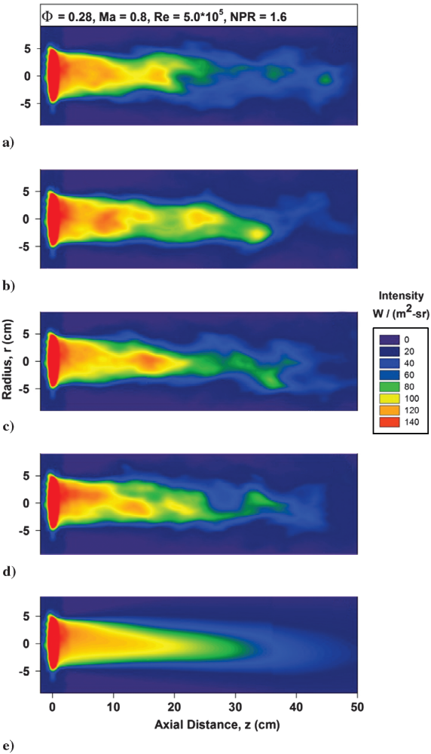
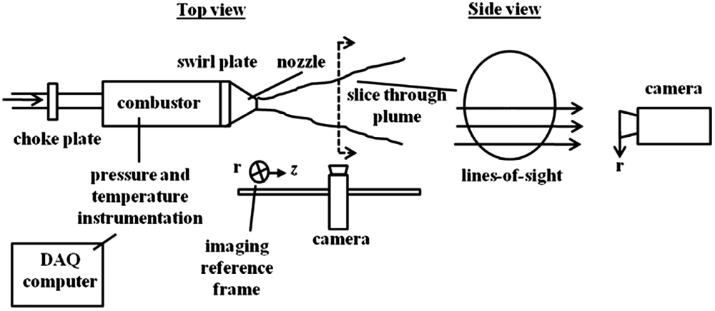
Examples
Arrangement for studying infrared radiation emissions from exhaust plumes.
[Blunck et al., JPP, 2012; Blunck and Gore, JPP 2011]

Slide 5
Sensors
They can be classified in several ways. For example, based on the
  physical variable measured
  imaging area: point or whole field measurement
  frequency response
  power requirements (active or passive)
  intrusive or non-intrusive nature of measurement
  Note: It is important to know how a measurement system works and its limitations. Blindly trusting the results reported from an instrument can lead to large errors (e.g. example from graduate student)
Notes:
ME 451

Slide 6
2. Sensors for Temperature, Pressure and Flow Measurements
-A brief overview…. more details to come
Notes:
ME 451

Slide 7
Temperature Measurements
Point based measurement sensors: thermocouples, thermistors, RTDs
Non-intrusive single point sensors: single detector infrared sensors
Non-intrusive field measurements: IR cameras, liquid crystal thermography, laser induced fluorescence
  (Discussion regarding measuring temperature in a reacting flow and intrusive versus nonintrusive measurements)
Notes:
ME 451

Slide 8
Pressure Measurements
Manometers
Capacitance-type transducers
Strain-gage based pressure transducers
Piezoelectric pressure transducers
Most are single point, but some can be field measurements (e.g., pressure sensitive paint)
Notes:
ME 451

Slide 9
Flow Measurements
Differential pressure flowmeters
  Orifice
  Venturi
  Nozzle
  Laminar Flow Element
Velocity based flow measurement
Thermal mass flowmeters
Coriolis flowmeters
Turbine flowmeters
Vortex flowmeters
Rotameters
Notes:
ME 451
Operating principle of the rotameter leads us into a discussion of the interaction between a solid surrounded by fluid. Many other interesting phenomona occur as a result of the drag force exerted by the fluid. The fluid dynamics of these flows has to be studied in great detail in order to design objects that require lesser power, for example.

Slide 10
Calibration
What: Process of establishing a relation between value of the input to the measurement system (the physical variable) and system output
Why: measurement system does not, in most cases, directly measure the input
How: use a “standard”for the physical variable as input to measurement system and note the output
Notes:
ME 451

Slide 11
What is a standard?
A device/object/phenomenon that establishes a quantitative value to a unit that is unique
Features:
  Availability
  Reliability
  Stability
Ex: dimension: mass- unit: kg (we will use SI units as much as possible)- standard: mass of a particular platinum-iridium bar
Notes:
ME 451

Slide 12
Signal Processing
Notes:
ME 451

Slide 13
Waveform Classification
Sensors acquire signals; these physical signals are typically continuous in time, & magnitude (Analog).
A sensor can only acquire this physical signal magnitude at specific intervals of time (Discrete time)
In most cases, only an approximated magnitude of the continuous signal is available at specified time intervals. (Digital signal)
signal
signal
signal
Δt
Δt
time
time
time
Analog
Discrete-time
Digital
Notes:
ME 451

Slide 14
Quantization
8 V
111
7 V
110
6 V
101
5 V
signal
100
4 V
011
3 V
010
2 V
001
1 V
000
δt
0 V
time
The magnitude of the digital signal is determined from the analog
signal by a process called “quantization”
Notes:
ME 451

Slide 15
Signal Sampling Concepts
Sampling time interval, (Δt): time interval between two consecutive data points
Sampling frequency/rate, (f_{s}) : 1/sampling time interval
Number of samples, (N): total number of samples collected over a given time interval
Total sampling time: NΔt
How fast should a signal be sampled in order to truly represent its dynamic nature? Don’t neglect the possibility of aliasing during analysis.
Notes:
ME 451

Slide 16
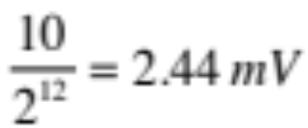
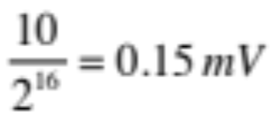
Analog- to-Digital Conversion
A computer stores analog data in a digital form- the process of conversion of analog to digital signal is performed by Analog-to-Digital Converters (ADCs).
ADC is a hybrid device with both analog and digital components. The analog side is specified in terms of a full-scale (input) voltage range, E_{FSR} (ex., 5, 10V)
The digital side is specified by the number of bits in the register (ex., 12, 14, 16 bits)
Thus, a 12-bit ADC can resolve a 10V E_{FSR} to
while a 16-bit ADC can resolve the same 10V E_{FSR} to
This is the least resolution error present in ADC process, and is referred to as a “quantization” error
Another important specification for the ADC is the conversion frequency (when would this be important)
Notes:
ME 451

Slide 17
Review - Objectives for Lecture
Gain an introduction to measurement systems

